Slide 1
Triggers
Primer review

Slide 2
Triggers (“fire” like a SPROC exec)
DDL (server or database level)
Events: Create, Alter, Drop
ON [database , server]
DML (table level)
Events: Insert, Update, Delete
ON [tablename]
Types of DML Triggers
For/After (fires an action after event)
Instead of (prevent or divert change)

Slide 3
Triggers
An automated system action you create as a stored procedure.
Syntax:
CREATE TRIGGER ddl_create_database
ON ALL SERVER
FOR CREATE_DATABASE
AS
PRINT 'Database Created.'
Naming Convention
Level
Firing Event
Action

Slide 4
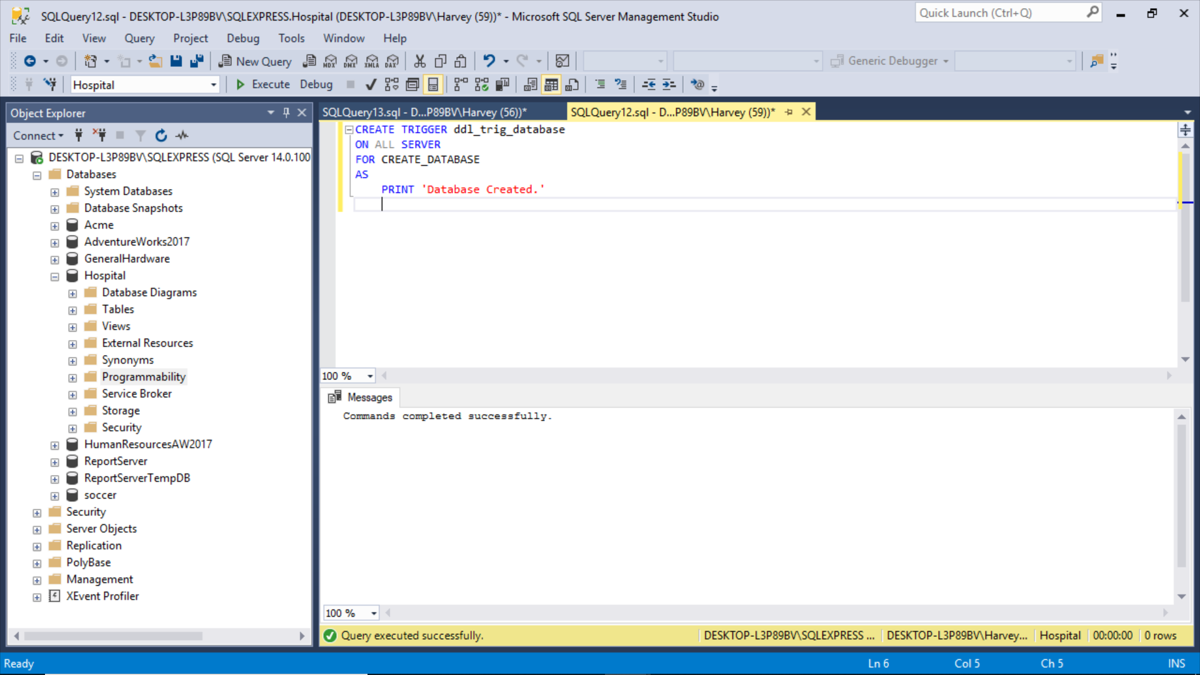

Slide 5
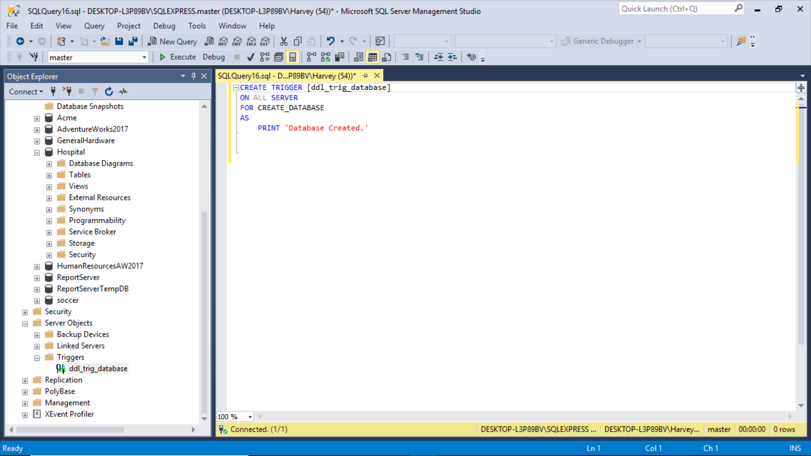
Server level trigger

Slide 6
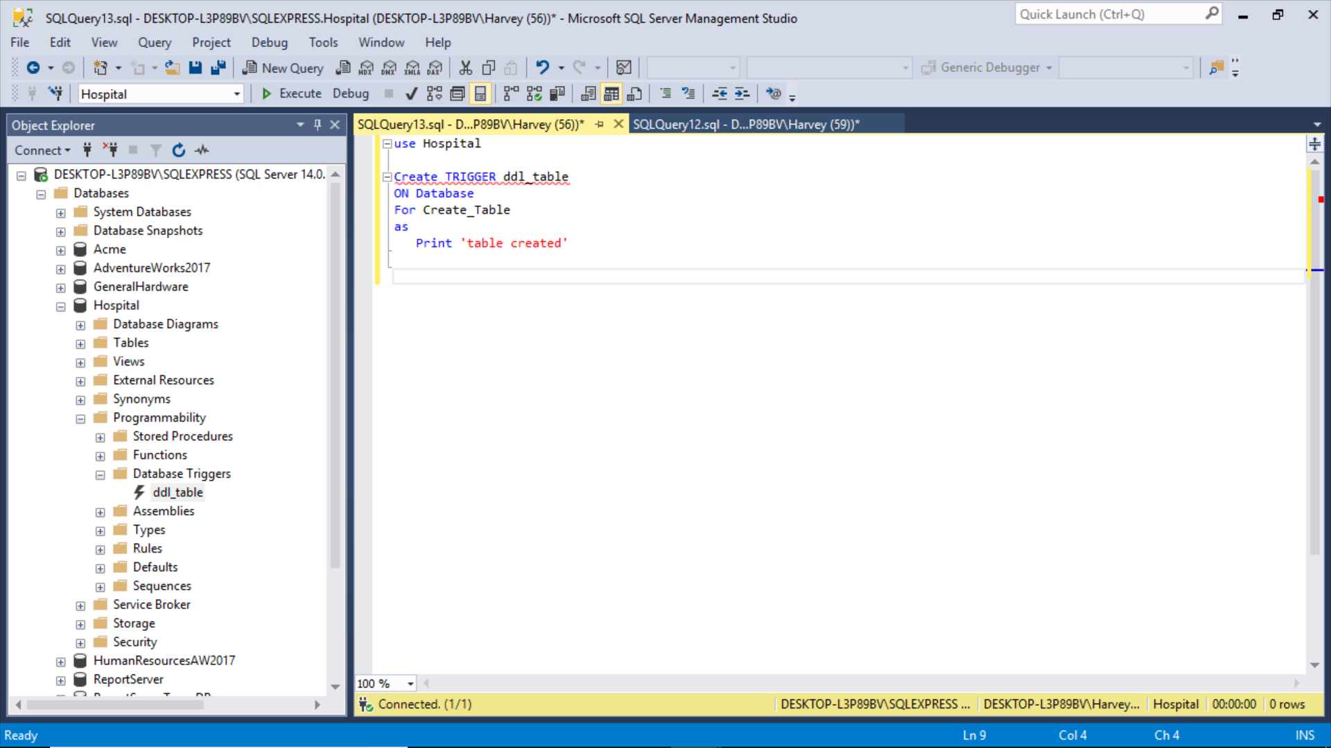
Database level trigger

Slide 7
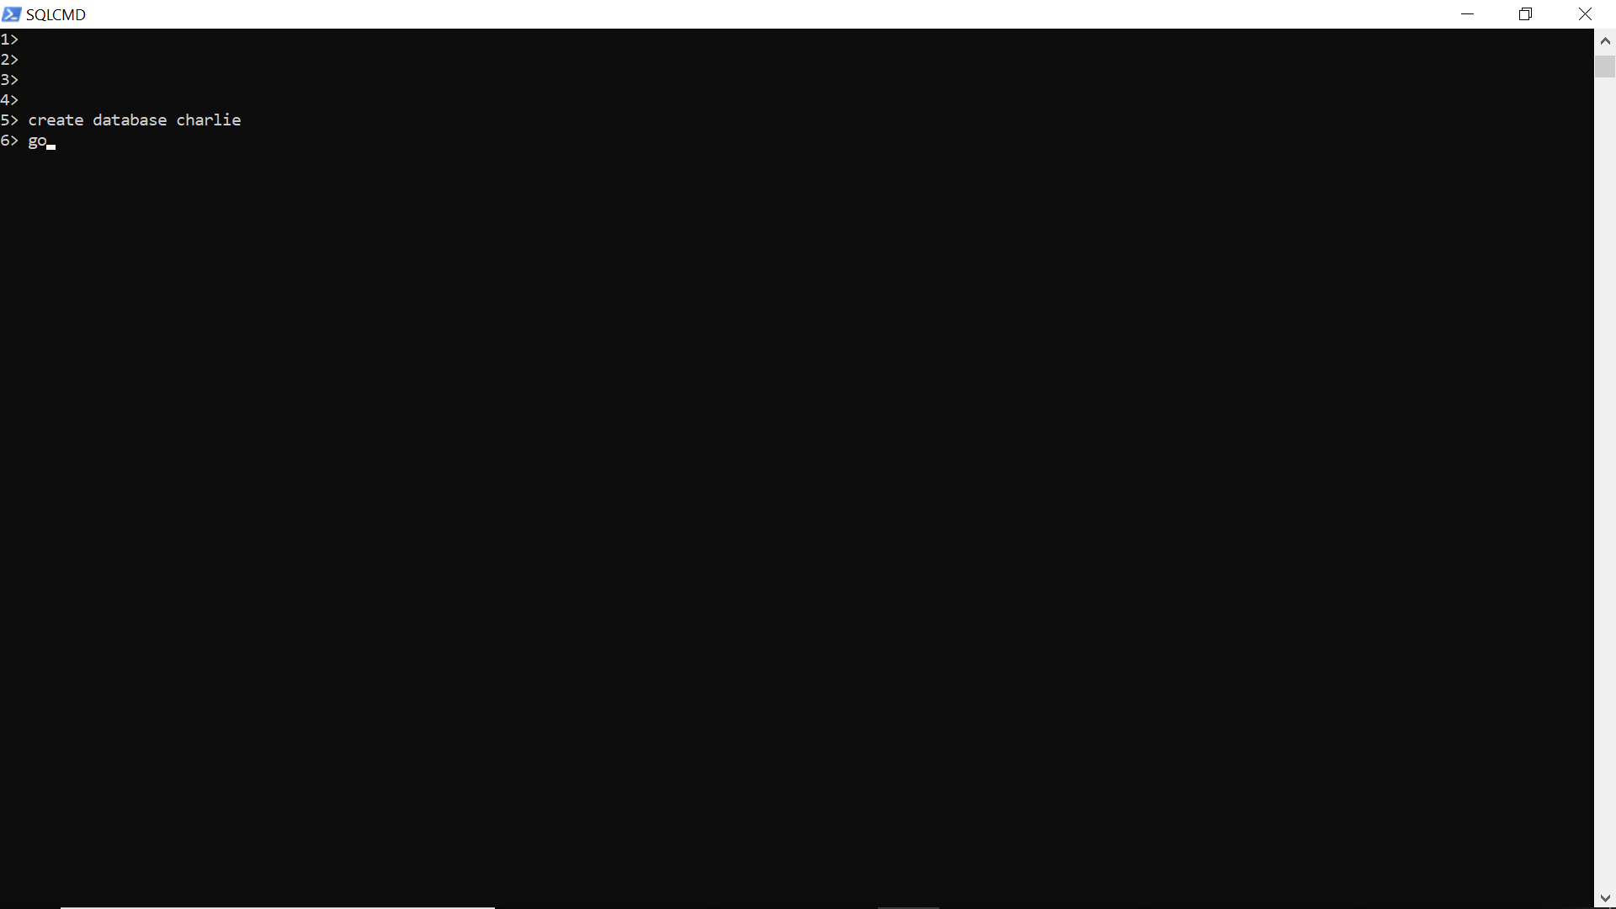
Let’s try it out (server level trigger – create database)

Slide 8
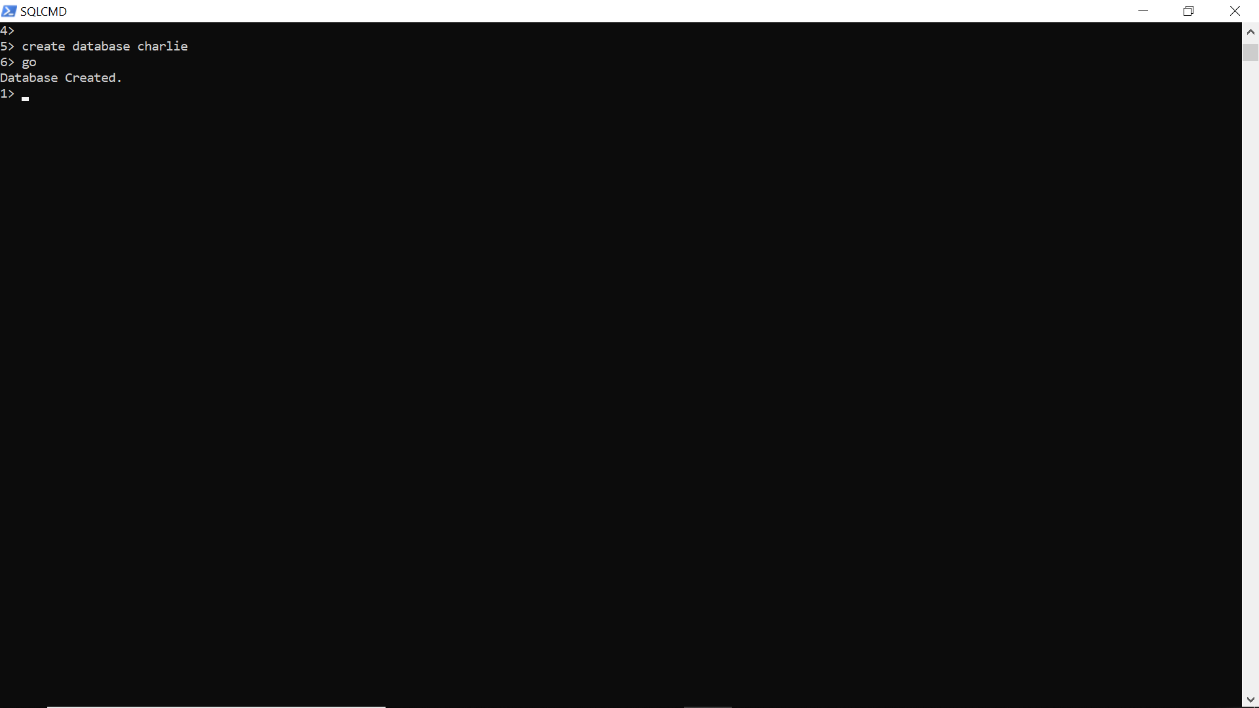
A trigger to give the use feedback - solves the “blinking cursor problem”

Slide 9
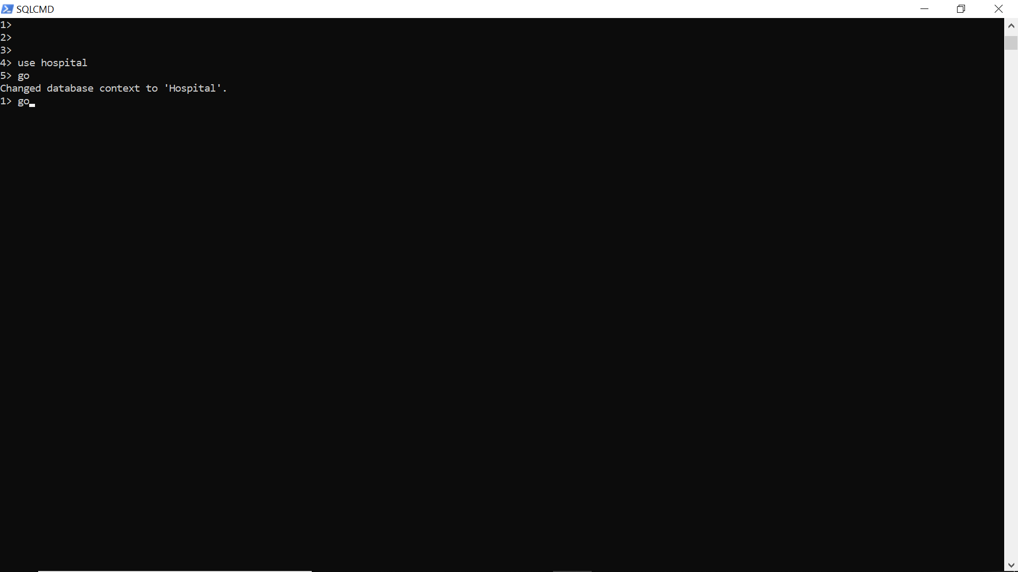
Now try database level Trigger (create table)

Slide 10
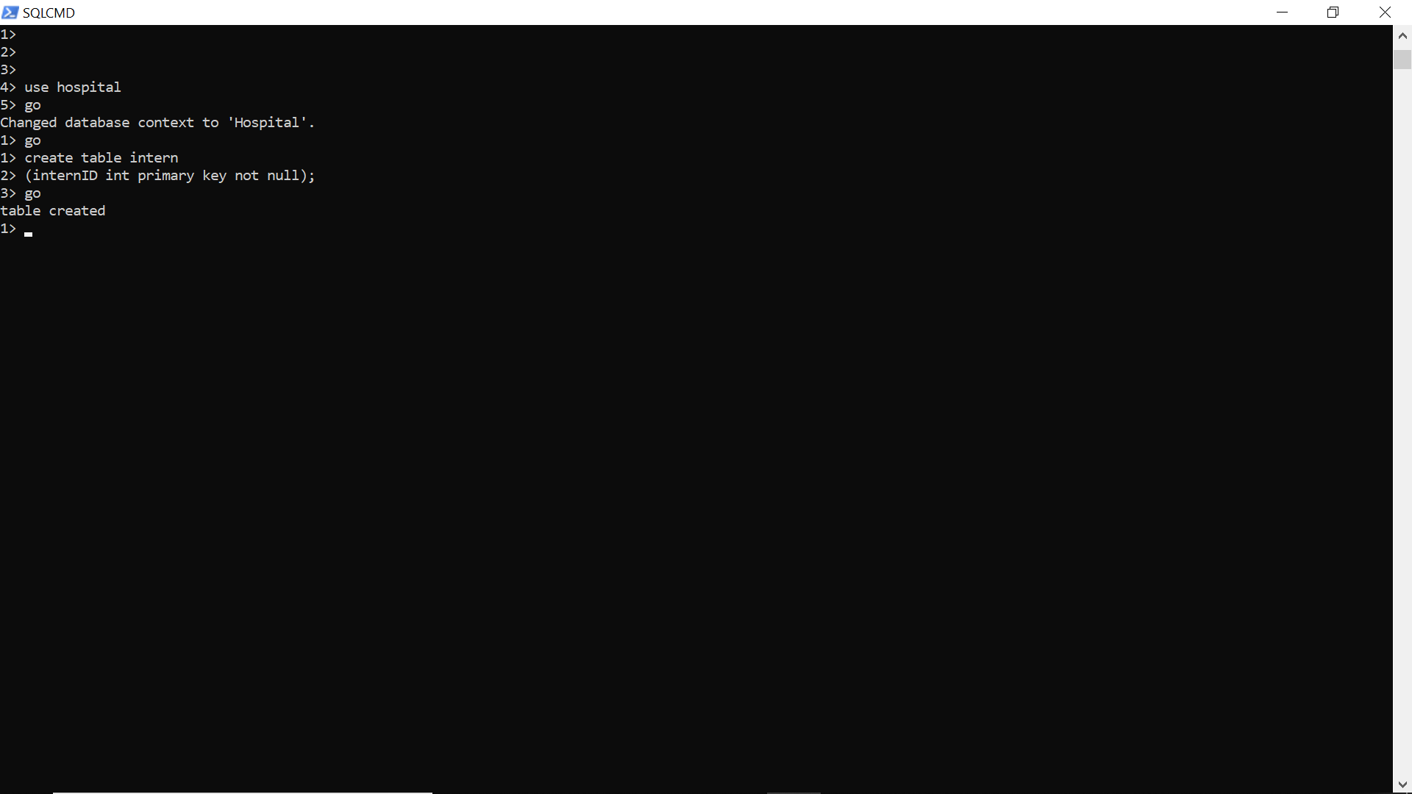
Same thing here: “did I create the table?”
Oh, yes I did, the system just sent me a message.

Slide 11
Triggers lessons
These are hard to learn, can be hard to trace through the system.
Syntax heavy, rigid, can block operations and slow down performance.
Very advanced, very complex.
Highly situational (DDL vs DML)
Usually done by DBA or admin, sometimes developer depending on permissions and roles.
Reason is you need certain permission levels depending on level of trigger and event.
Very dangerous, so use with caution, and experiment with dummy data a lot!
You can do really cool things with them like prevent accidents/mistakes such as drops, deletes, updates and modifications.
Roles don’t always prevent mistakes, when the action is within a role.

Slide 12
Table Level (DML) Trigger: Using “Instead of” to Prevent a Delete Operation
Table level trigger will prevent any row from being deleted.
Think of this as a try/catch.
create trigger dml_delete_bed
on bed
instead of delete
as
print 'you should never delete rows'
rollback
create trigger dml_delete_patient
on patient
instead of delete
as
print 'you should never delete rows'
rollback

Slide 13
Trigger Exercise
Create a for trigger if a user attempts to delete a record that record is written to a backup table.
Create an instead trigger to prevent a record from being deleted.
Create a for trigger to print a message for any action of your choice.

